Slide 1
Liaison Meeting
KMC
July 26th 2026

Slide 2
Welcome
Apologies
Fire regulations
Notes:
Apologies
Thanks for attendance
Success of Liaison rep. would also like to investigate deputies – on notice Board

Slide 3
Agenda
Minutes of the previous meeting held 21st February 2026.
Solihull Masonic Temple Limited, Company accounts
Menus and catering arrangements
Drinks and bar arrangements
Museum and Insurance update – Richard Kennedy
Board Roles
Board Activity “Third Rising”
Board activity
Any other business

Slide 4
Minutes of the previous meeting held
21st February 2026.
Notes:
Available on the website.
If you attended the meeting and deem them worthy of acceptance …

Slide 5
Solihull Masonic Temple Limited,
Company accounts
Year End 30th June 2023, 2024 & 2025.
Notes:
Another major achievement in getting the accounts completed and submitted to Companies House. Only just on deadline day.
Left with UXB and short fuse.
A lot of sleepless nights.
To do the job properly you have to “wear” the problems.
Previous frequent penalty fees and penalty points.
Asked for contact none received.
Now we can move forward on a sure basis.

Slide 6
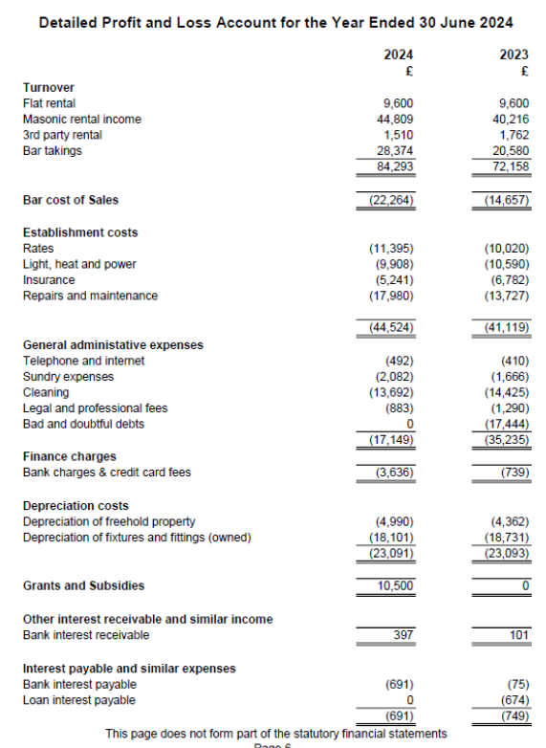
Notes:
I’ll try and answer any questions

Slide 7
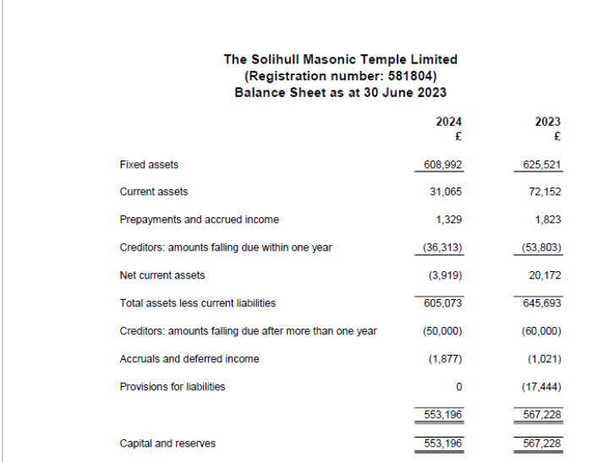

Slide 8
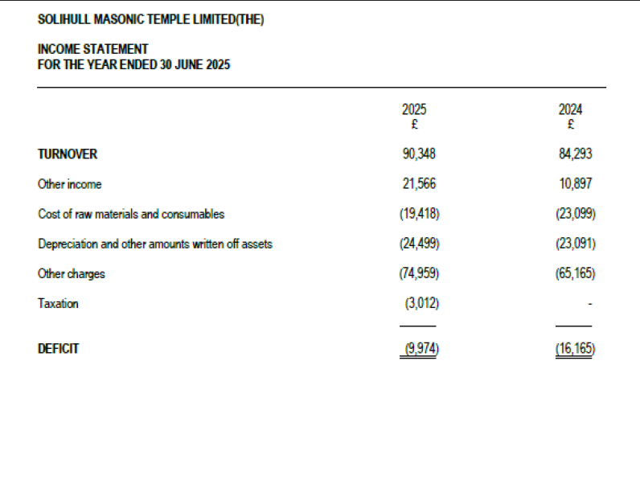

Slide 9
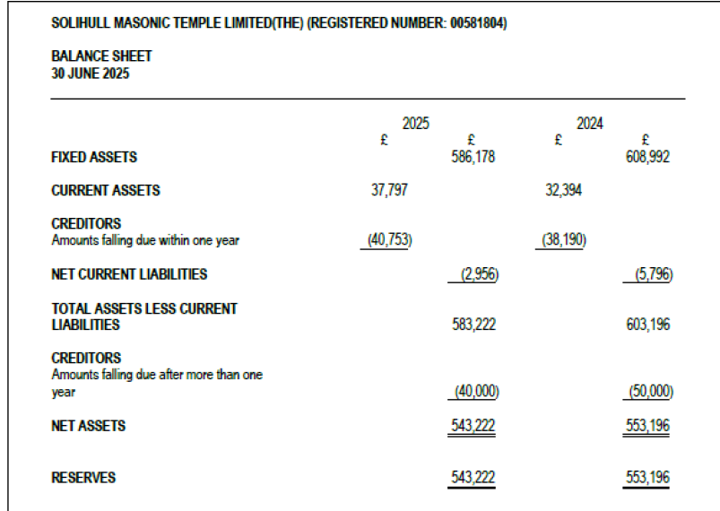

Slide 10
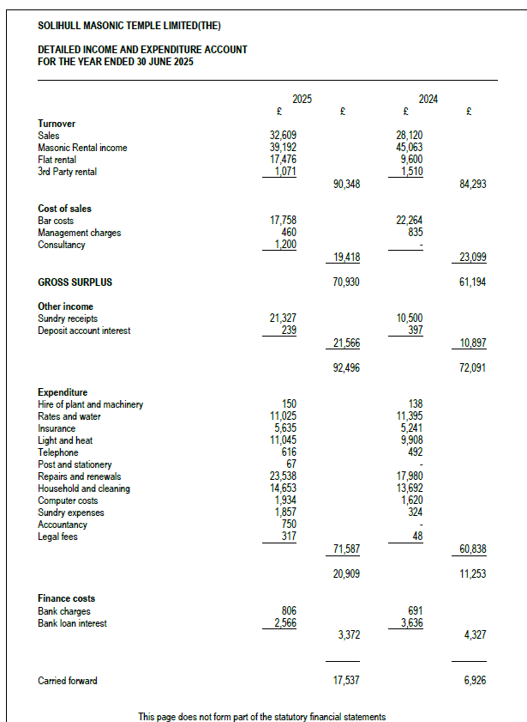

Slide 11
Menus and Catering
2026 / 2027

Slide 12
Key Points
Prices
  Sharer £25. Current £23
  Formal £31. Current £29
  Buffet Menu A £16 Current £15
  Buffet Menu B £19.50 Current £18
Improvements /Additions – Formal Menu
  3 Additional Starter courses.
  Steak selection.
  3 Other extra courses.
  3 extra Desserts
  Chicken Breast – often dries out poor quality will be replaced with a chicken meal similar to fish pie.

Slide 13
Principal Menu Vegetarian
Improvements /Additions – Vegetarian Menu
  A lot of discussion between Vegetarian diners but not with Board or Rupert
  Difficult to get feedback from all Vegetarian diners.
  Those making comments were in isolation.
  Got further reports from diners who did not comment.
  Need to say something please.
  Better feedback from Mark than diners.
  Started a review process.
  Result of feedback
  Choice of 7 meals not 4
Notes:
Suggestion that I should try Vegetarian meals was politely declined.

Slide 14
Principal Menu Bespoke Menus
I’ve spoken to Rupert for a while asking for a bespoke dining option.
Proves that Rupert is a highly skilled and experienced Chef
Specialised menu for Solihull Lodge got high praise.
Page 13 and 14.
I asked for a Carvery menu. Very popular at Kings Heath.
Available on request £31
Wide range of desserts.

Slide 15
Units must help themselves
Frequent complaint is vegetables cold looked “grey”
Vegetables unappetising
  Process
    Mark sets room up
    Mark serves at bar.
    Prepares vegetables on site.
    Serves meals – produced at Sils and kept hot. Cold for desserts if appropriate.
    If a Unit arrives beyond the time booked / arrives at the bar slowly or in dribs and drabs, just like at home the vegetables get over boiled.
    Solution – a bell has been added to the Secretary’s pedestal. Use at an appropriate rising.

Slide 16
Bar Prices
Prices should have gone up last year but didn’t. An effort to be nice.
New bar prices will be on display.
Supported by general broadcast.

Slide 17
Rentals 2026/27
Policy of KMC is for Rentals to increase by RPI.
Rentals will therefore increase by 3%.
Current meeting £247.72 future £255.15 (+£7.43)
Current per Capita £3.47 future £3.57 (+£0.10)

Slide 18
Board Roles
  Craig Thompson to remain as a Director without specific role.
  David Perkins – Non-Executive Secretary has asked to step down due to his health.
  Recent Email for another Board Member

Slide 19
Museum & Insurance
Richard Kennedy

Slide 20
Commercial Insurance Review
When David joined the Board in 2023, he saved KMC £1k by achieving a 20% reduction in premium.
David asked me to take over responsibility for the commercial insurance.
  Achieved a further reduction of 20% and a saving of £800.
  In addition, the new policy includes increased
    Employer’s liability, loss of license, increased loss of revenue etc.
  Contents insurance - all Units need to send a valuation of all equipment.

Slide 21
Board Activities “Third Rising”
Income & Expenditure
The Flat
External Actions
Internal Actions

Slide 22
Income - InPost Boxes
Simon Bumford of Wythall Lodge brought to my attention the boxes recently installed at Kings Heath. (Image below).
The Board has agreed that these boxes will also be installed at KMC giving an increase to 3rd party income.
The boxes will be sited on the wall of the Lodge Room. (Image).
We are currently arranging boxes for InPost(Shein)and Veep(DPD).
A third one is under consideration.
This income will be the third largest source of income for the rooms, after Slimming World and 1 Unit.
When the 3rd one is agreed the boxes will provide the largest income source for the rooms.
Although not necessary, contacted neighbours. Athos staff were really excited because boxes would be there.
Notes:
1 m “skirt” all parties – as per APL

Slide 23
Income
Slimming World
  I secured their attendance at the rooms from the British Legion
Very happy to move to KMC as I offered a fixed price for 12 months.
Made welcome by Rose and now trusted.
Largest single income for KMC.
Wythall Lodge 5665
Worcester Lodge
Those 2 sources have covered the lost income of Units who returned warrants Doric, Justice and Solihull.

Slide 24
Income 2
Simon Bumford of Wythall Lodge brought to my attention the boxes recently installed at Kings Heath. (1st Image).
The Board has agreed that these boxes will also be installed at KMC giving an increase to 3rd party income.
The boxes will be sited on the wall of the Lodge Room. (2nd Image).
We are currently arranging boxes for:
InPost (Vinted) and Veep (DPD).
Income will be the 3rd largest, after Slimming World and only 1 unit.
A third one is under consideration.

Slide 25
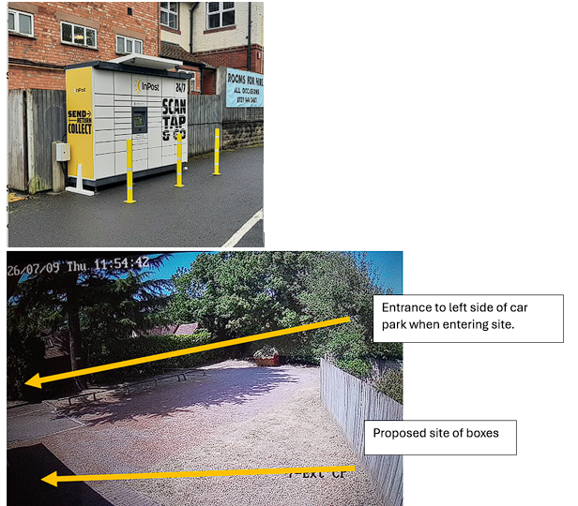

Slide 26
The Flat
New tenant has been in the flat since 11th May
10% increase in rental income.
A new cooker and fridge freezer have been installed.
Flat has been painted – walls and architrave.
Tenant is also decorating at her own expense.
Porch and hall not painted because we wanted to let the property as soon as possible. This is on the to do list. The porch has not been painted since at least 2021.

Slide 27
External actions
The grounds, including the foliage overhanging the pavement has been cleared.
This was an outstanding item, delayed by the previously reported cashflow issues.
I am the first Chairman, in my time at the rooms to investigate the Title Deeds of 1621 Warwick Road Solihull.
After reference to the Company Solicitors, I found that Athos and Trigo, our neighbours are each liable for 15% of the cost of maintenance.
The bill was reduced therefore reduced by 30%.
There is now a weekly maintenance contract in place.

Slide 28
Internal actions
EICR – remedials completed await sign off
Leak in flat going into Haskins room fixed.
New front doorbell installed – now no need to leave door on the latch
Secretary’s desk bell.
TV blanked off
3 emails on the subject ignored / didn’t read / too many people pulling out cables. On a previous occasion £200 repair bill.
    H&S risk – Directors get sued.
  New TV if HDMI plugs / socket get damaged
Not your TV

Slide 29
Internal actions - 2
Carpets cleaned
Glasses “deep clean”
Last out Lights out – Lodge room lights left on even after meeting finished.
Royal Arch candles replaced.
Community presence – PCSO consultation group

Slide 30
The Foodbank
Foodbank - Estimate only one Mason is leaving things. Slimming World has brought in 10 times more. Put on summons email. Leave something by your case so you don’t forget.
This is ….. Use own words.
Only a recent occurrence, Keith Reynolds often had to empty a full basket weekly.
There are 3,250 attendees plus visitors a year.
There are 150 Lodge meetings a year.
There are therefore 300 Officers and LOI meetings a year.

Slide 31
Any
Other
Business

Slide 32
Thank you

Slide 33
Next
Liaison
12th September 2026

